Slide 1
DATA retention time in GDp
As long as business needs it. Each signed-off delivery as of a Reporting Date should be re-creatable
GDW Object
Global Architecture Board
Enterprise Ontology
Search & Consume (access consumption views via multiple channels)
BI Reports
Business Metadata
Search & Find
Explore/Discover
Std Reports
MSTR
Glossary
Semantic Layer (standardises schemas and drives Business Centric Data Access)
Subject Specific Marts & Dimensions (MSTR Layer)
DG Tool (Metadata)
Catalog/ Dictionary
Consumption Views
(Virtualised Datasets)
EKG
DiaAllz
Midcorp
Direct
Biz to Tech
Mapping
Consumption Domains
(Virtualised/Physical Datasets)
Domain Marts & Conformed Dimensions
Technical Metadata
Claim
Contract
Party
Finance
Schema to Schema Mappings
ABS
Data mappings
…
Harmonised OE Model
(Virtualised/Physical Datasets)
Data Warehouse
Harmonised Enterprise Data Schema (internal & external data)
Data mapping
Ingestion Service
Raw Layer
(Source Datasets)
Transient
Quarantined
Long Term
Always keep the 2 last deliveries for the same As At Date until one version is signed off. Then move to LT
Only the signed off version for each As At date submission
As long as business needs it
Data retention period

Slide 2
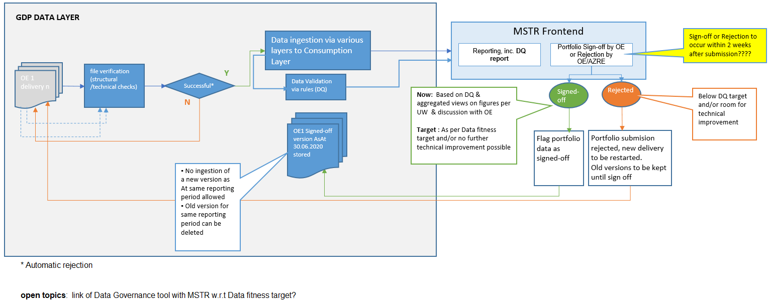
Sign-OFF process
FOR DISCUSSION

